Slide 1

Project Glass
The PMO portfolio tracker
Every project, every person and every pound in one place — and a plan that books the people it needs.
For project managers, delivery leadership and the executive team
Notes:
Project Glass is a portfolio tracker built for how a delivery office actually works: one place for the projects, the people and the money, with a planning tool that feeds straight into resourcing. Everything you will see is live software, not mock-ups.

Slide 2

WHY THIS EXISTS
Three questions nobody can answer quickly
Most delivery offices keep the portfolio in one spreadsheet, the resourcing in another and the plans in a tool nobody else opens. The numbers stop agreeing the moment anything changes.
?
?
?
Which projects are
actually at risk?
Who is overbooked,
and when?
What happens if
this slips?
Status is a colour someone typed last month, not something the numbers show.
Commitments live per project, so nobody sees the person underneath them all.
Plans and resourcing are kept apart, so a slipped task moves nothing else.
Project Glass answers all three from one set of figures.
Notes:
The point to land here is that these are not reporting problems, they are data problems. When the portfolio, the people and the plans live in different files, no amount of reporting effort makes them agree.

Slide 3
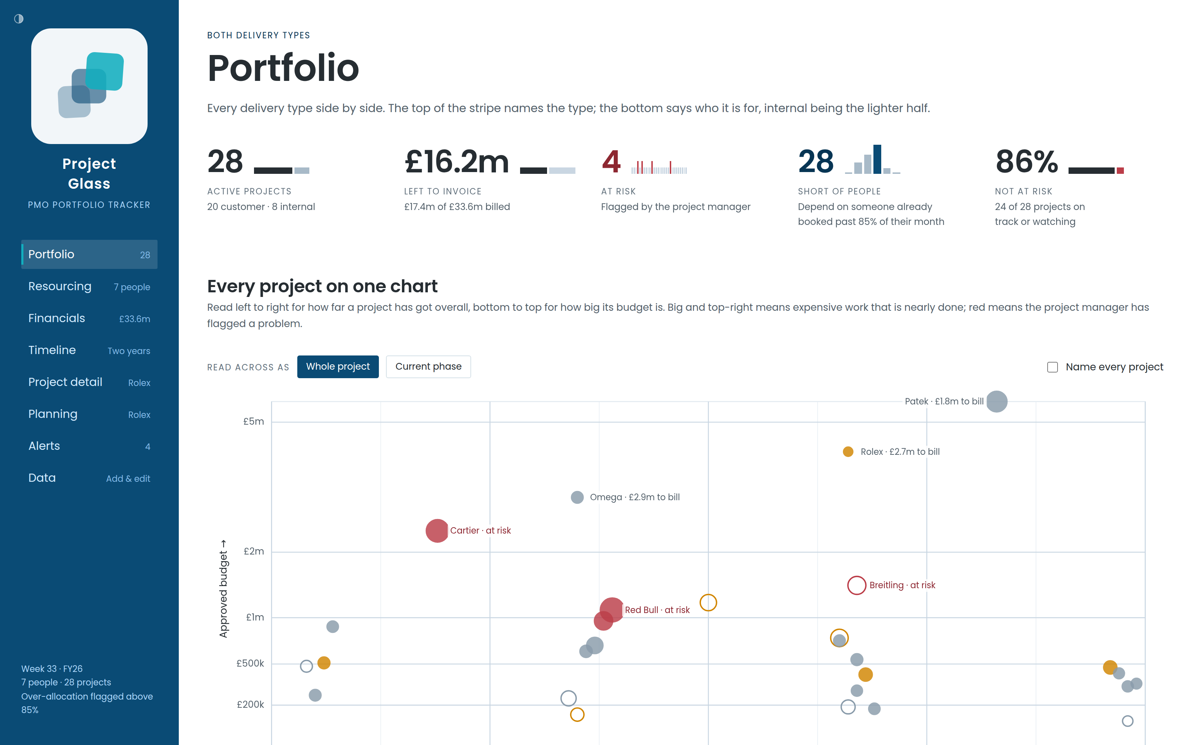
WHAT IT IS
One place, one set of numbers
1
Portfolio
Every project side by side, with the four things that matter on top.
2
Resourcing
What each person has already promised, month by month.
3
Financials
Budget, spend and invoicing, in the currency each client is billed.
4
Timeline & Planning
Where the work sits in time, and the plan that puts it there.
Notes:
Eight areas, one underlying set of data. Change a booking and the portfolio, the alerts and the financials all move together, because they are all reading the same numbers rather than their own copies.

Slide 4
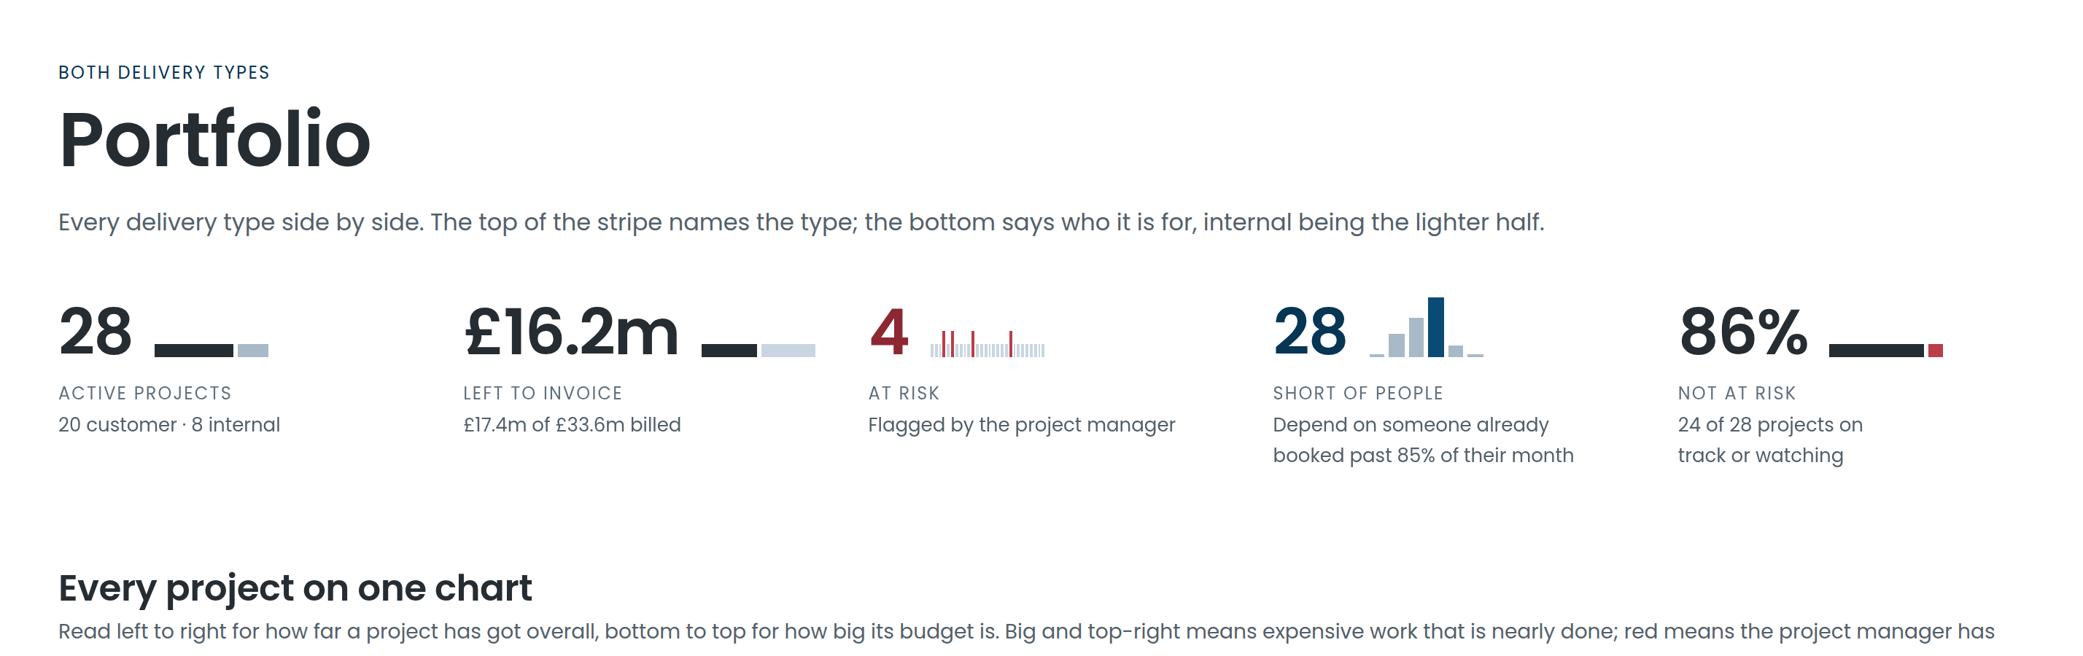
PORTFOLIO
The portfolio, in the first five seconds
28
4
£16.2m
86%
ACTIVE PROJECTS
AT RISK
LEFT TO INVOICE
NOT AT RISK
Split by delivery type and by who they are for
Flagged by the project manager, and shown in red everywhere
What is agreed but not yet billed
The KPI to hold, rather than the one to explain
Notes:
The top of the portfolio screen is built to be read at a glance in a governance meeting. Every one of these figures is clickable — the number is a way into the projects behind it, not just a headline.

Slide 5
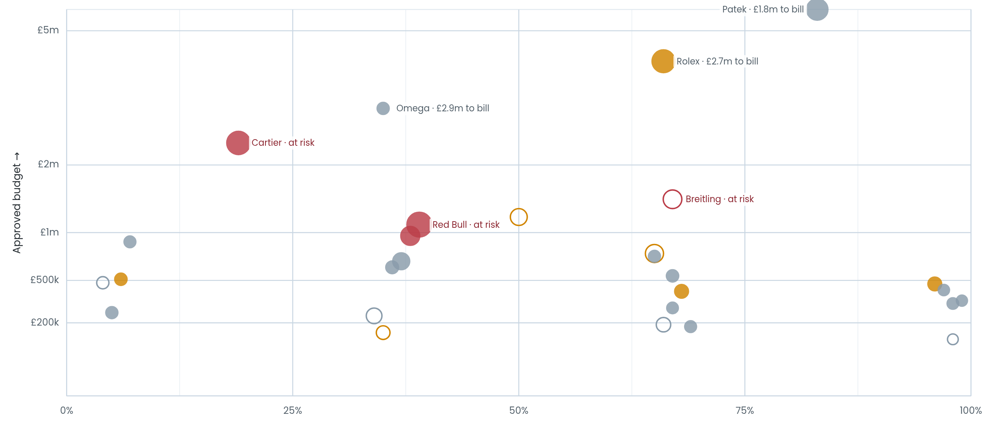
PORTFOLIO
Every project on one chart
One dot per project. Where it sits says how far along it is and how big it is; how it is drawn says whether anyone should be worried.
Left to right
How far through the work it is
Bottom to top
How big the budget is
Size of the dot
How much of the team it draws
Red
The project manager has flagged it
Notes:
Filter to one delivery type and the axis names that type's phases, so a position on the chart reads directly as "this one is in validation" rather than as a percentage.

Slide 6
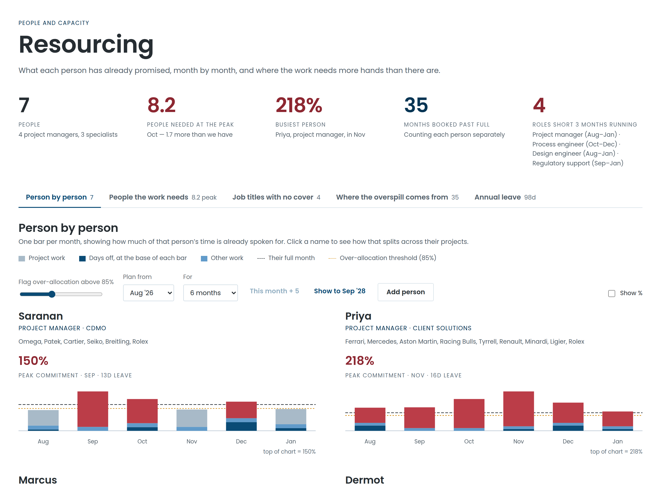
RESOURCING
Who is overcommitted, before it happens
1
One bar per person
Everything they have promised each month, across every project.
2
Days off at the base
Leave and public holidays come off capacity, not off the estimate.
3
A line you can move
Set the threshold; anything above it is flagged everywhere.
Notes:
This is the screen that changes conversations. Instead of "can you take this on", it is "you are at 124% in December, so something has to give" — with the projects causing it listed underneath.

Slide 7
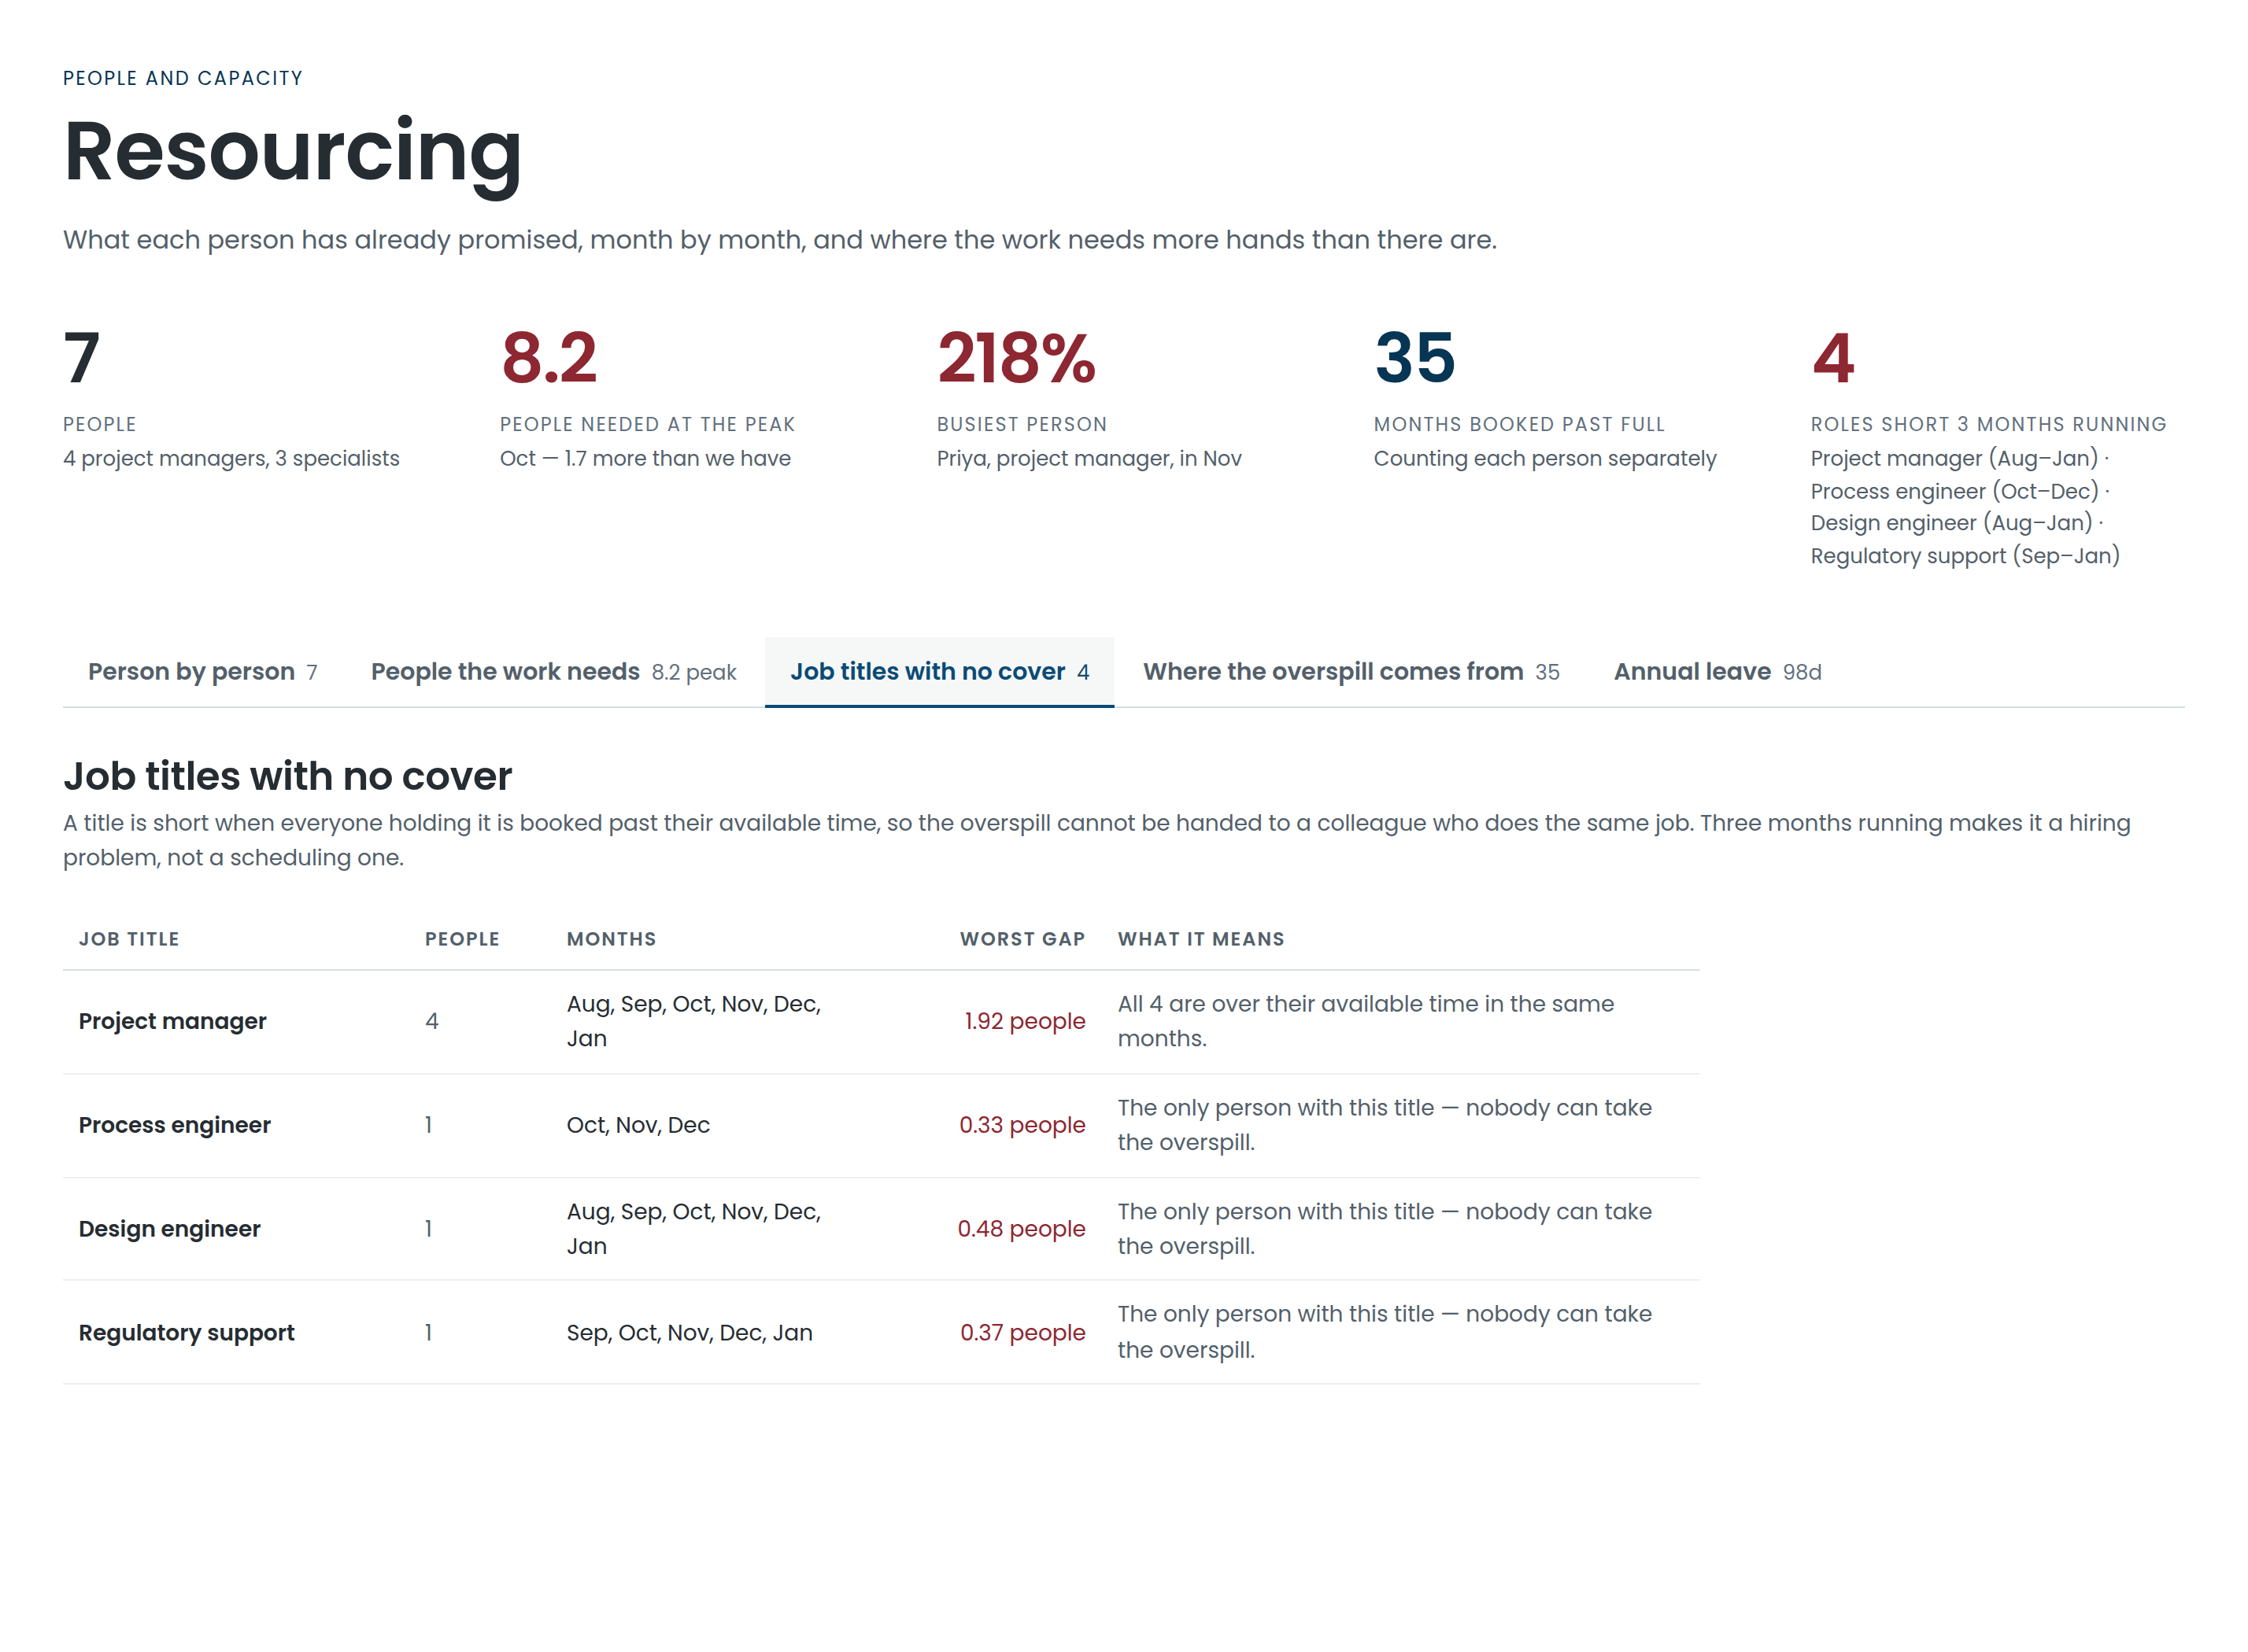
RESOURCING
The shortage a spreadsheet hides
A single busy month is normal. The same job title short three months running is a hiring decision — and it is the one thing a monthly capacity report will never show you, because each month on its own looks survivable.
4
8.2
ROLES SHORT 3 MONTHS
PEOPLE THE WORK NEEDS
Counted only where nobody else of that job title has room to absorb it
At its peak, against a team of seven — the gap, stated in people
Four roles, six months, nobody of the same job title free to cover them. That is a hiring decision — and it arrived as a number rather than as a feeling.
Project manager · Process engineer · Design engineer · Regulatory support — each short from August to January.
Notes:
This metric was built for the conversation with the executive team: it turns "we are busy" into "these four roles are short for six months and no one of the same job title can cover it".

Slide 8
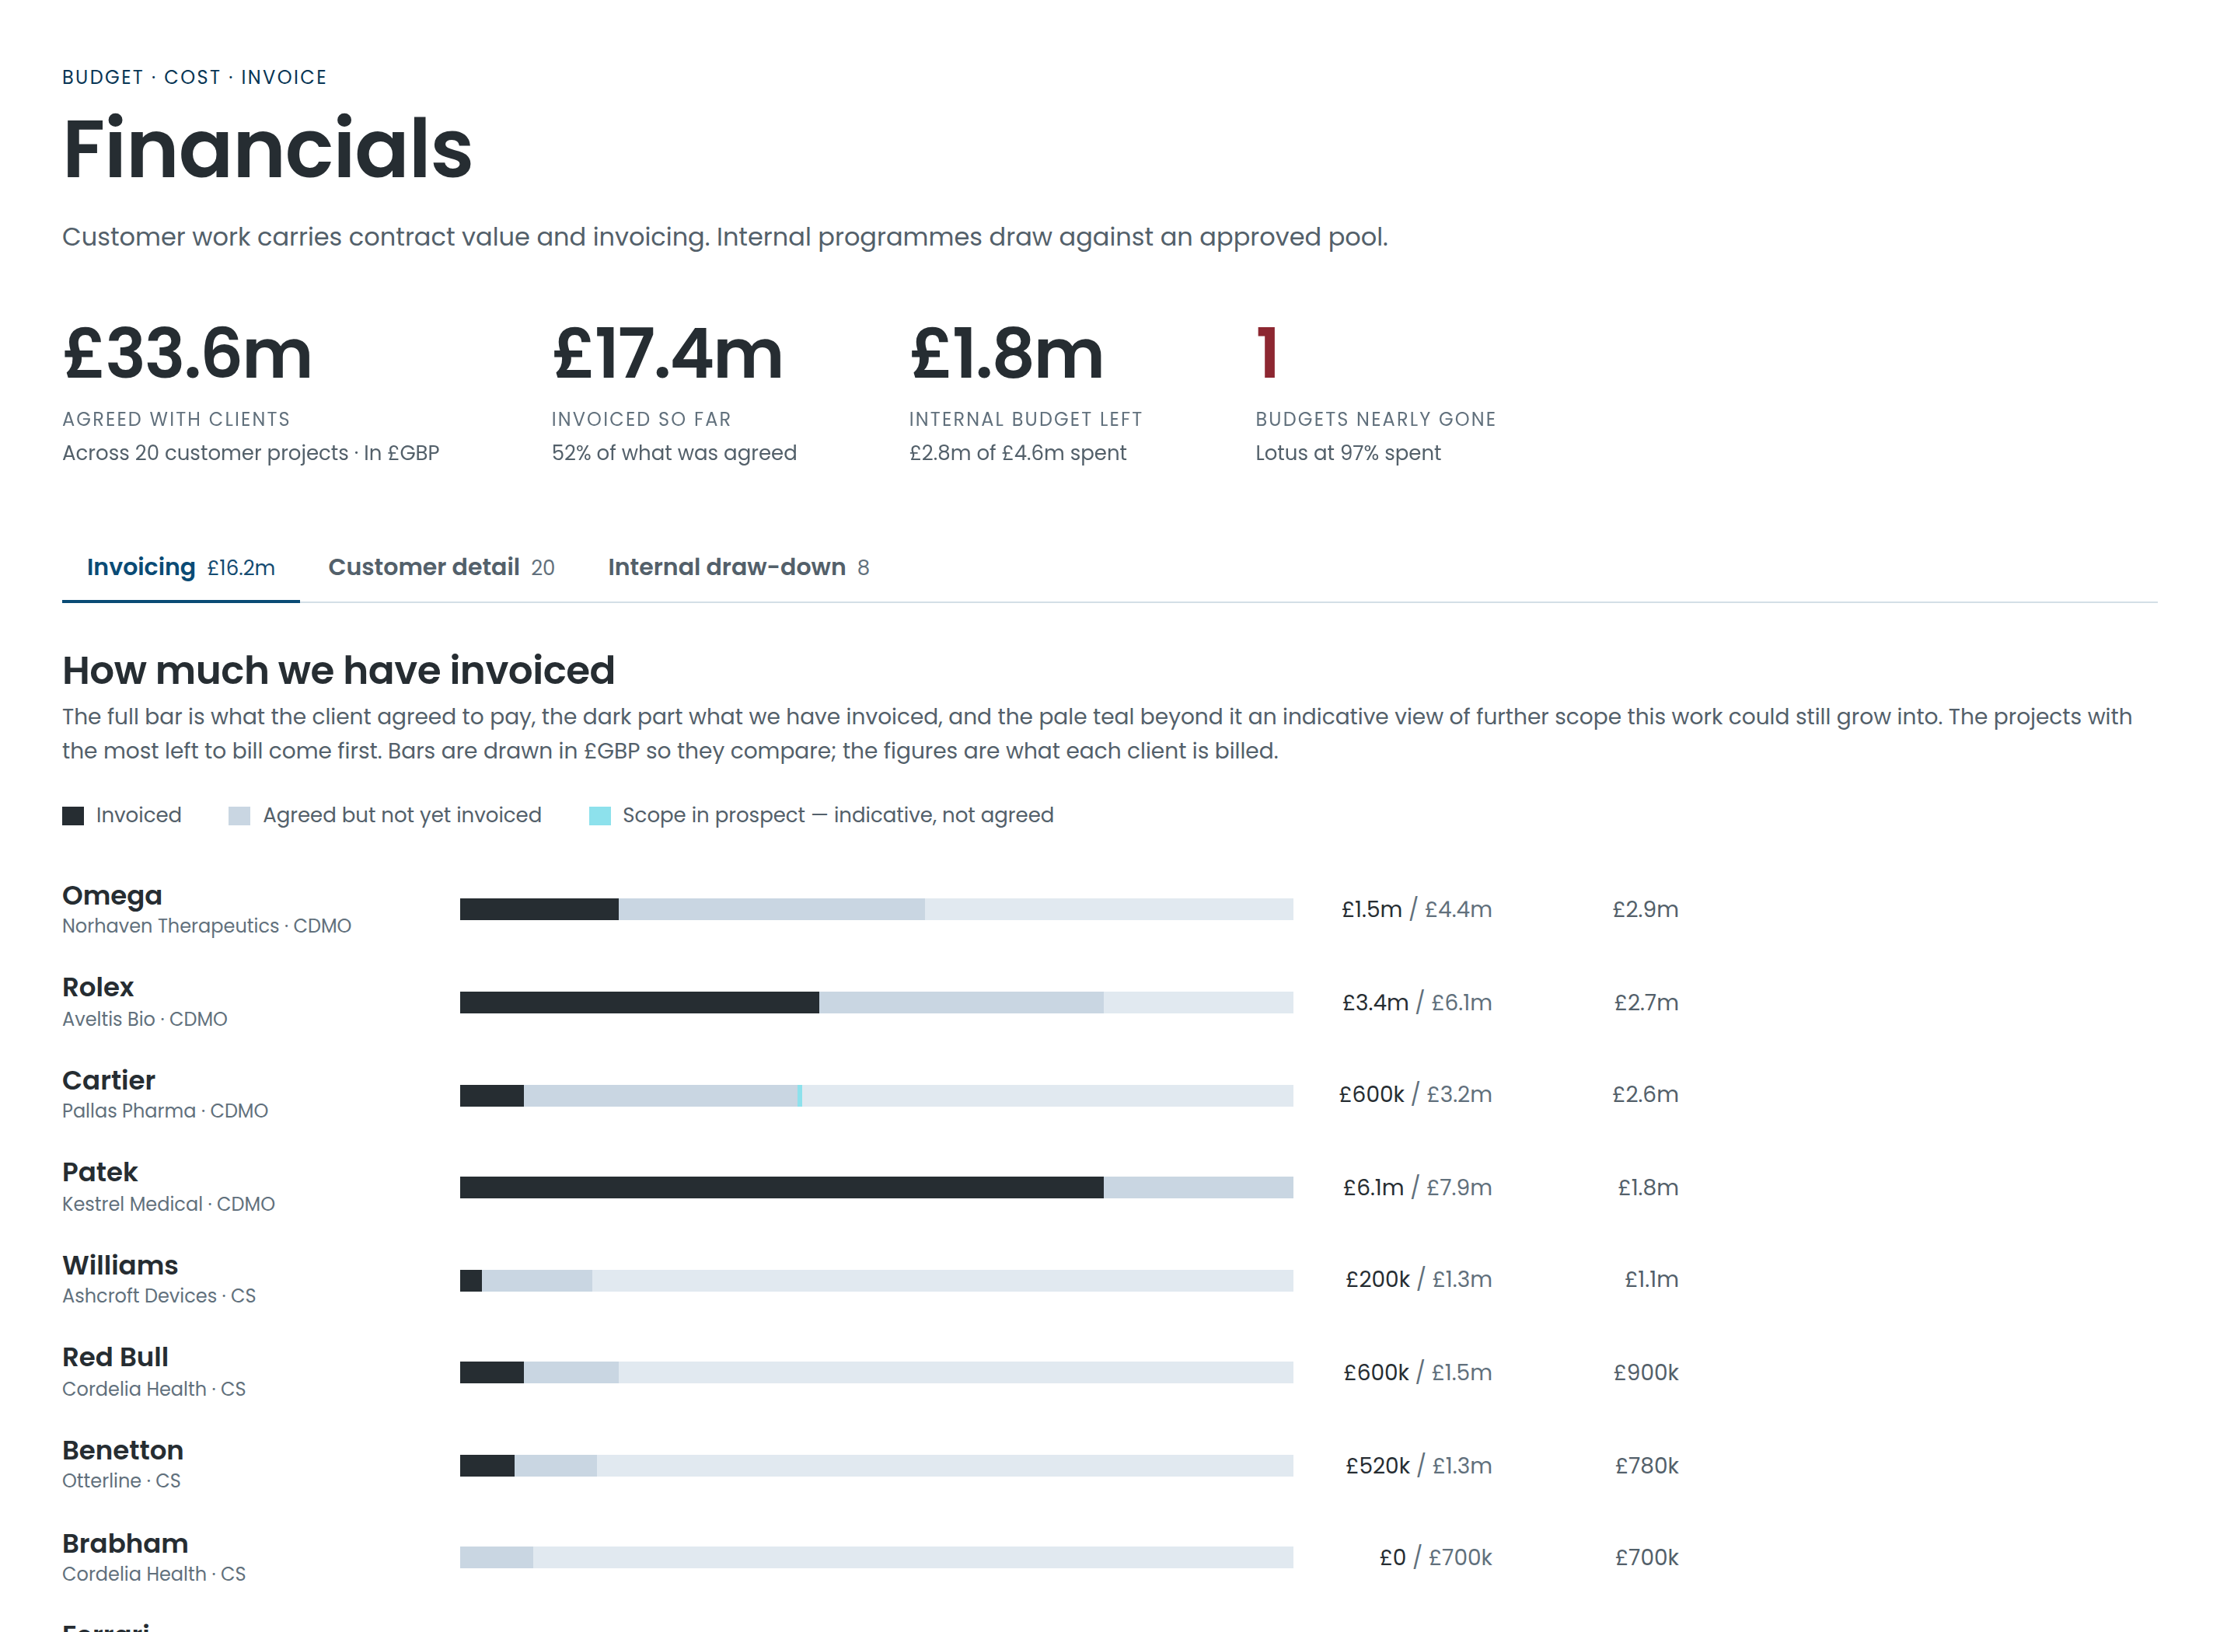
FINANCIALS
Budget, spend and invoicing, per project
1
Agreed versus billed
And the gap between them, which is the number finance asks for.
2
Three currencies
Billed in pounds, dollars or euros; ranked in one, so the list is honest.
3
Internal work too
Programmes with no invoice side still draw against an approved pool.
Notes:
Every column here sorts, so the same screen answers "who owes us the most" and "which budgets are nearly gone" without exporting anything.

Slide 9
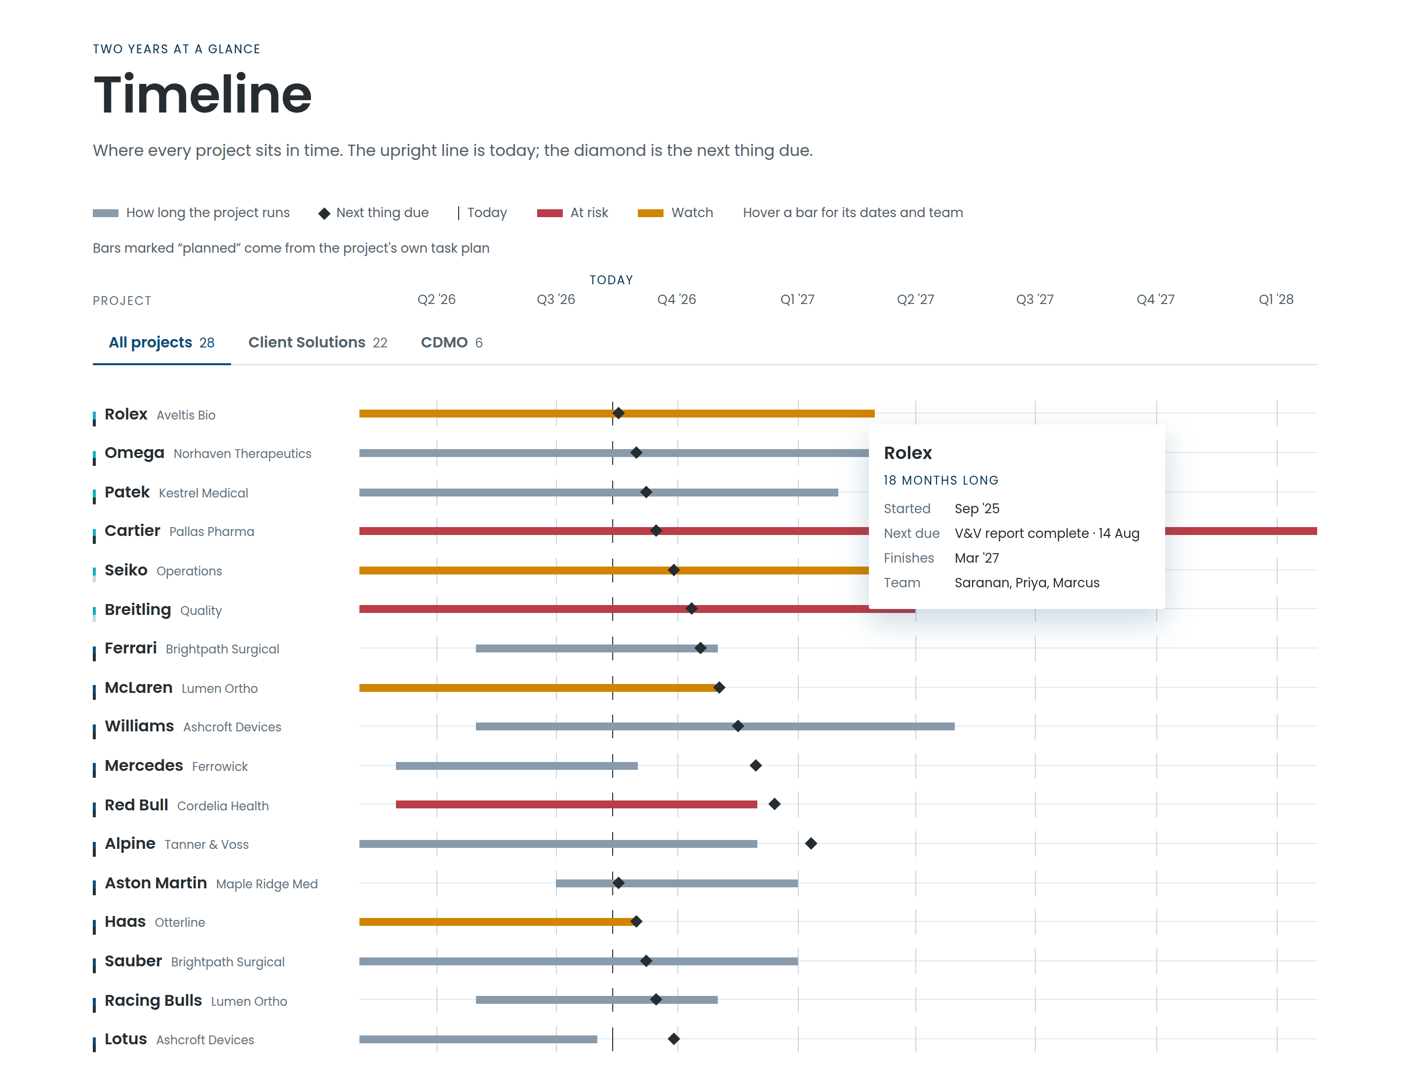
TIMELINE
Two years, at a glance
Every project as a bar, the upright line as today, and the diamond as the next thing due. Hover any row for who is on it.
Where the bar comes from
The dates typed on the project — unless the project is planned in detail and set to follow its plan. Then the bar is the plan.
Notes:
The timeline never guesses. A project shows the dates that were typed on it until someone explicitly says the plan is the truth, which keeps a half-built plan from moving the portfolio.

Slide 10
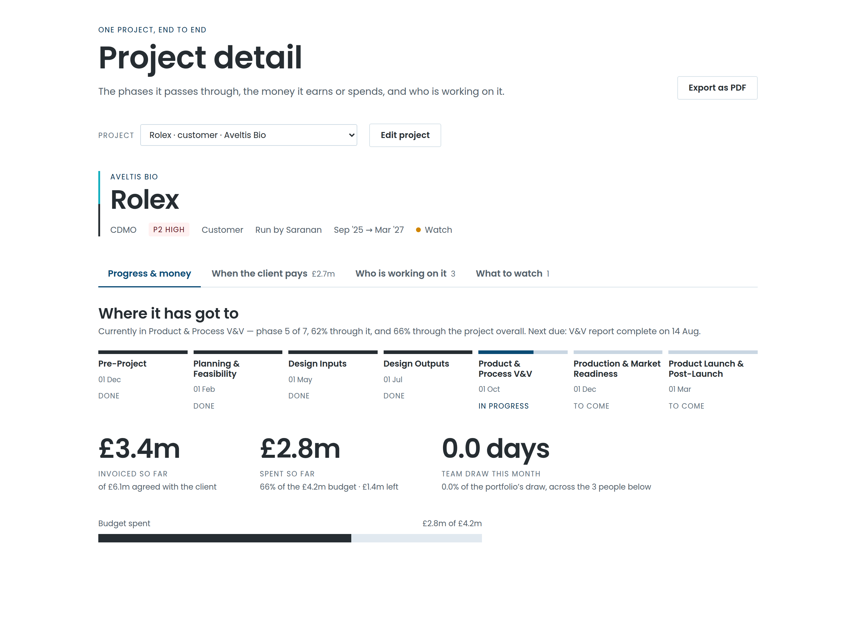
PROJECT DETAIL
One project, end to end
1
Its phases and gates
The dates for each, and how far through the current one it is.
2
The money
Budget, spend, what is agreed and when each invoice is due.
3
Who is working on it
Every person, every month, with their share of the project.
The whole screen exports to PDF, every tab included.
Notes:
This is the page a project manager takes into a review. The PDF export keeps every tab, so what gets circulated is the whole picture rather than whichever panel was open.

Slide 11
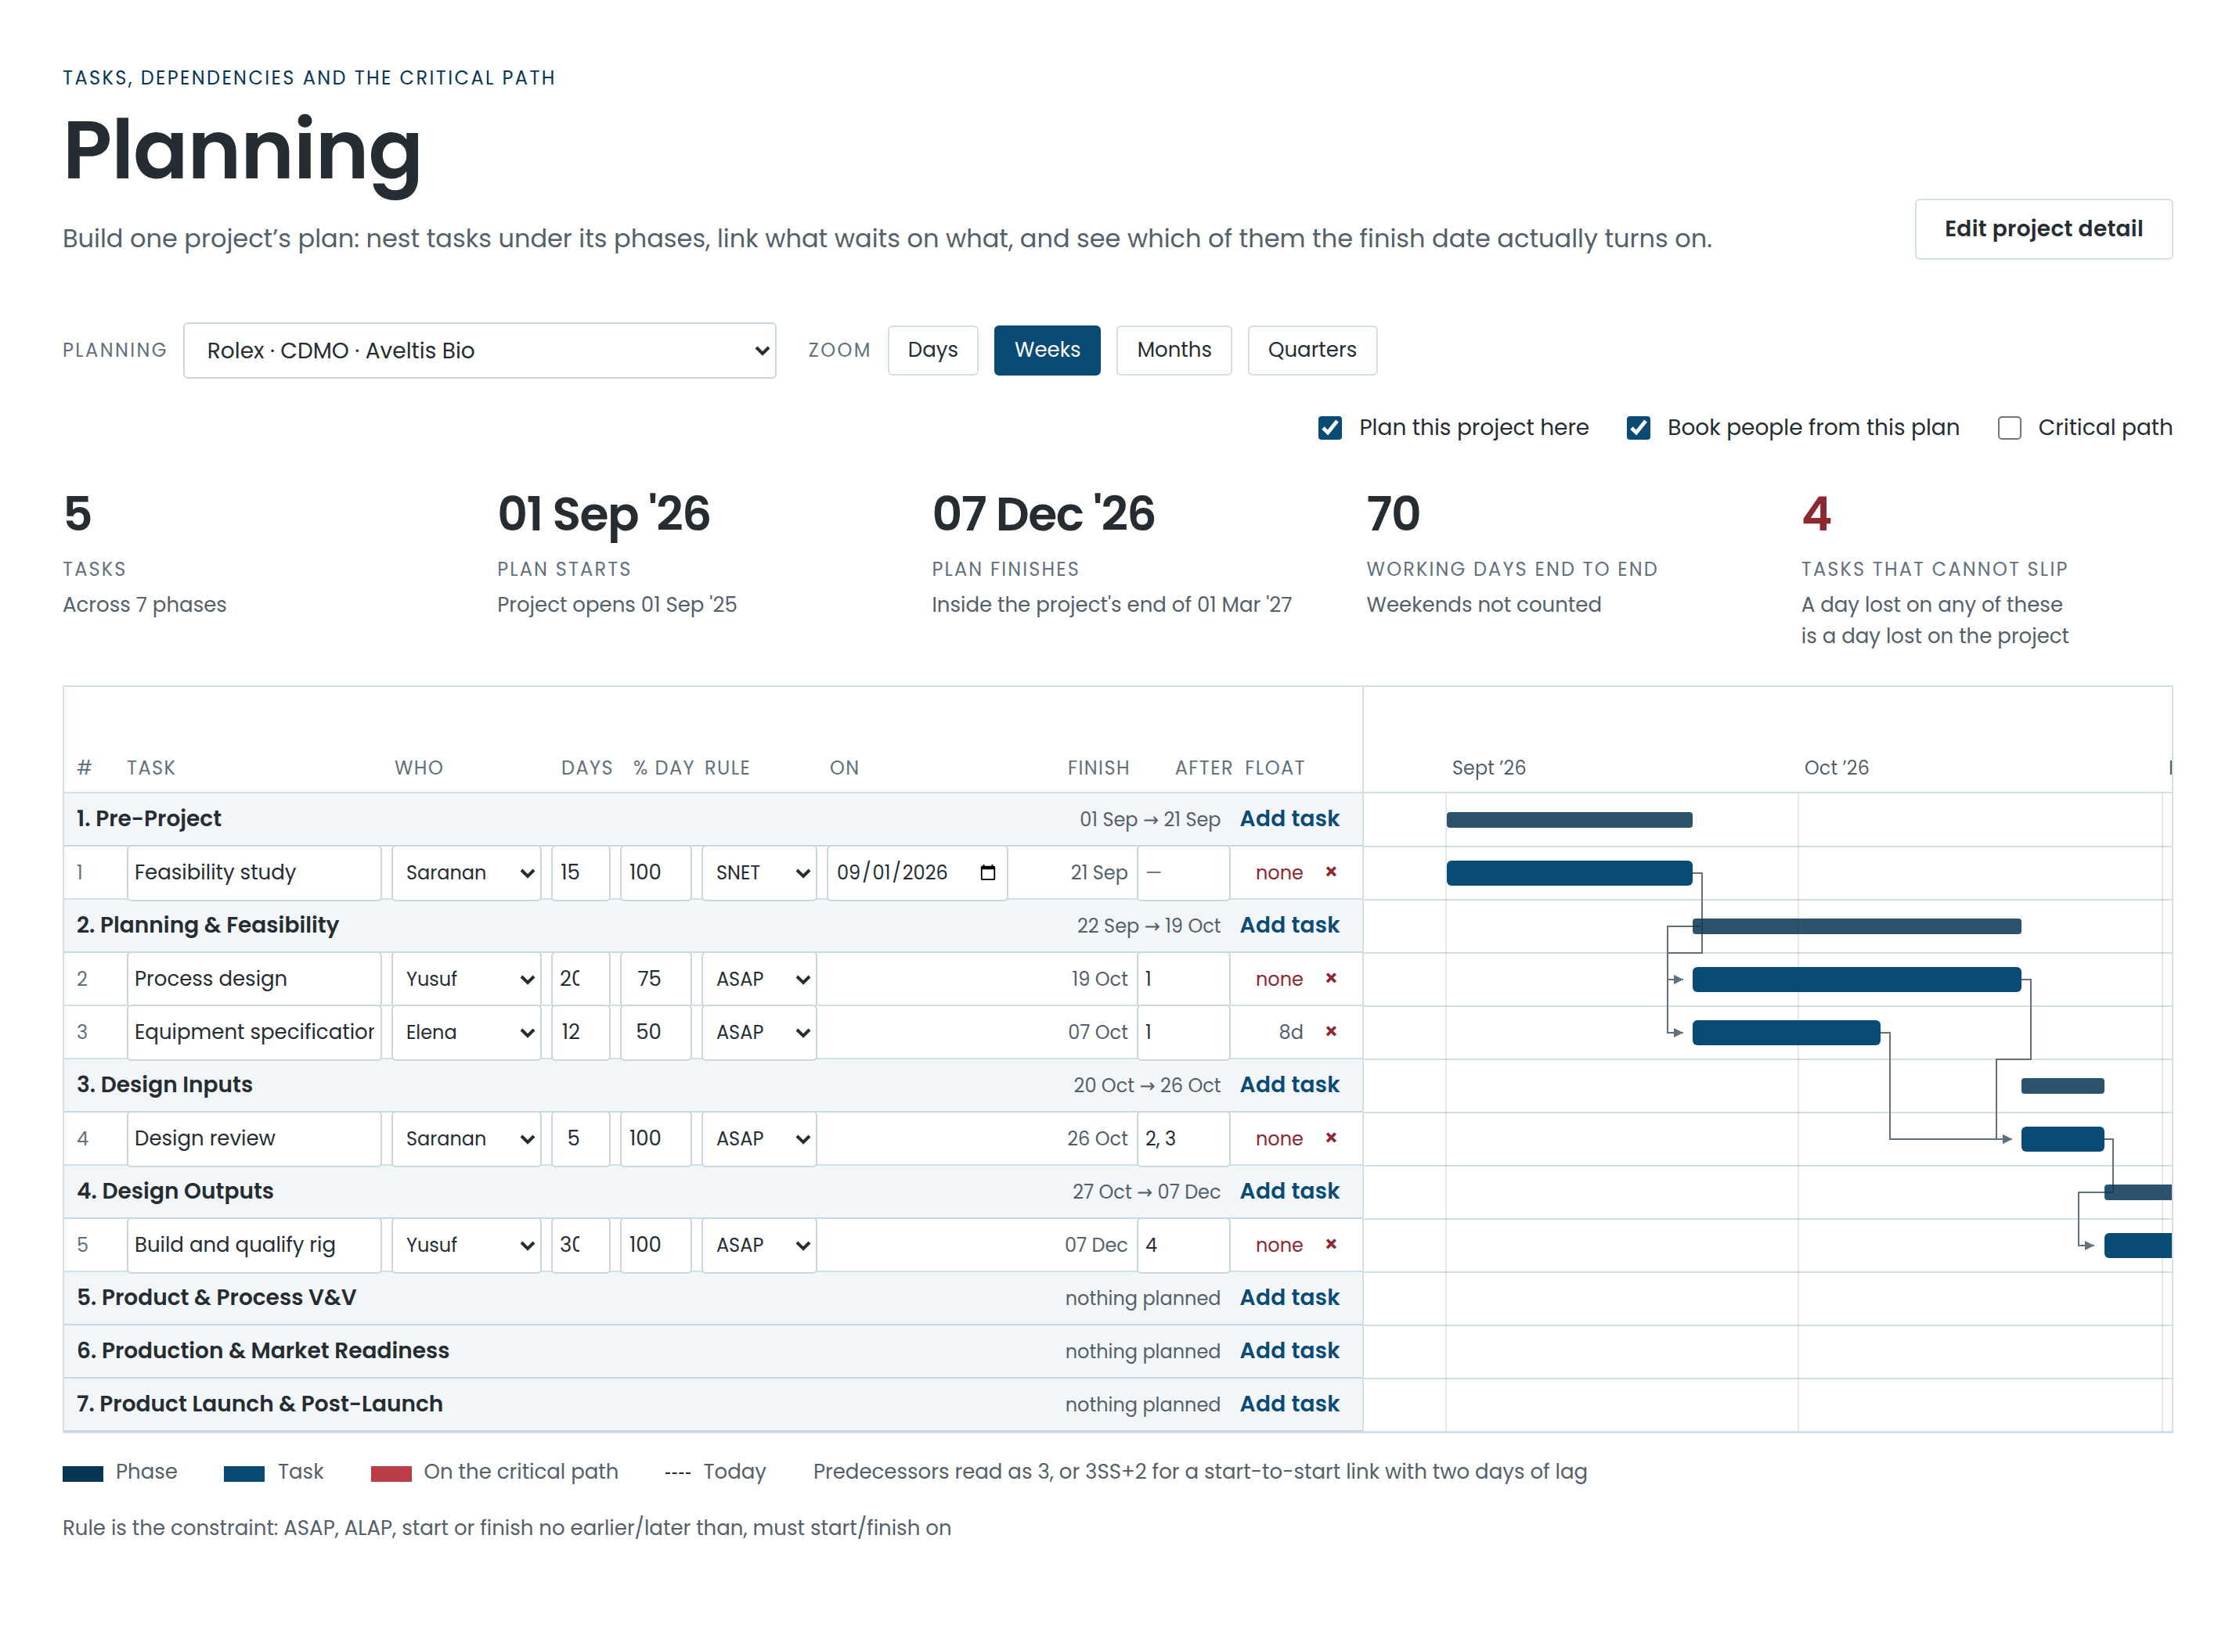
PLANNING
A real plan, not a picture of one
1
Microsoft Project dependencies
Finish-to-start and the other three, with lag, and eight constraint types.
2
The critical path
Which tasks the finish date actually turns on — and how much float the rest have.
3
Weekdays only
Work never lands on a weekend, so the dates are dates you could work to.
Notes:
The scheduler is the real thing: a forward and backward pass, float, and the four dependency types with lag. Nest tasks under the phases the delivery type already defines, and the plan feeds the timeline.

Slide 12
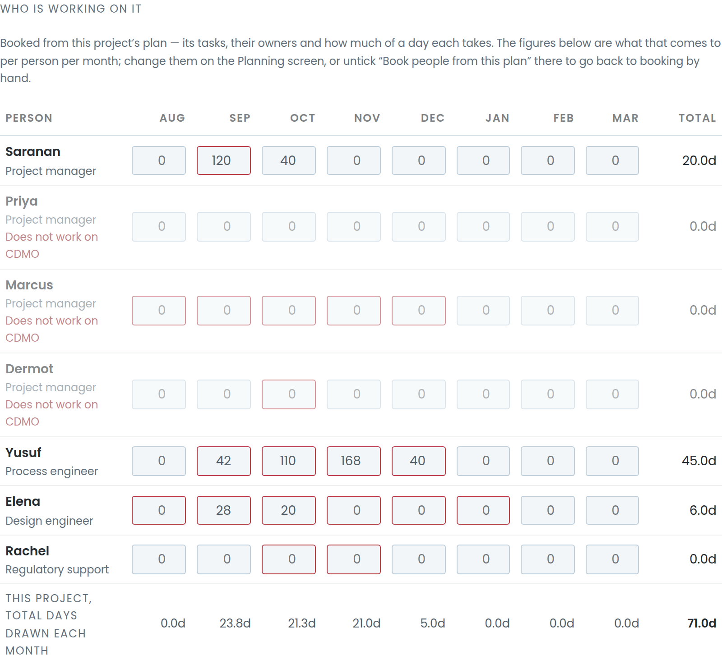
THE PART THAT SAVES THE ARGUMENT
The plan books the people
Give a task an owner and how much of their day it takes, and the hours land in resourcing by themselves — in the months the work actually falls in.
A 2-day task
At 50% of a day
= 8 hours booked
→
→
Two working days of work in the plan
It takes half of that person’s day while it runs
One day of their time, in the month it falls in
While it is on, the booking grid reports rather than accepts
Every figure still shows, per person and per month — greyed, locked, and labelled with where it came from. Nothing typed by hand is overwritten: untick the box and those bookings come straight back.
Notes:
This is the feature that closes the loop between planning and resourcing. The plan is the single source of the hours, but nothing is destroyed: the hand-typed bookings are set aside, not overwritten, and come back the moment the switch goes off.

Slide 13
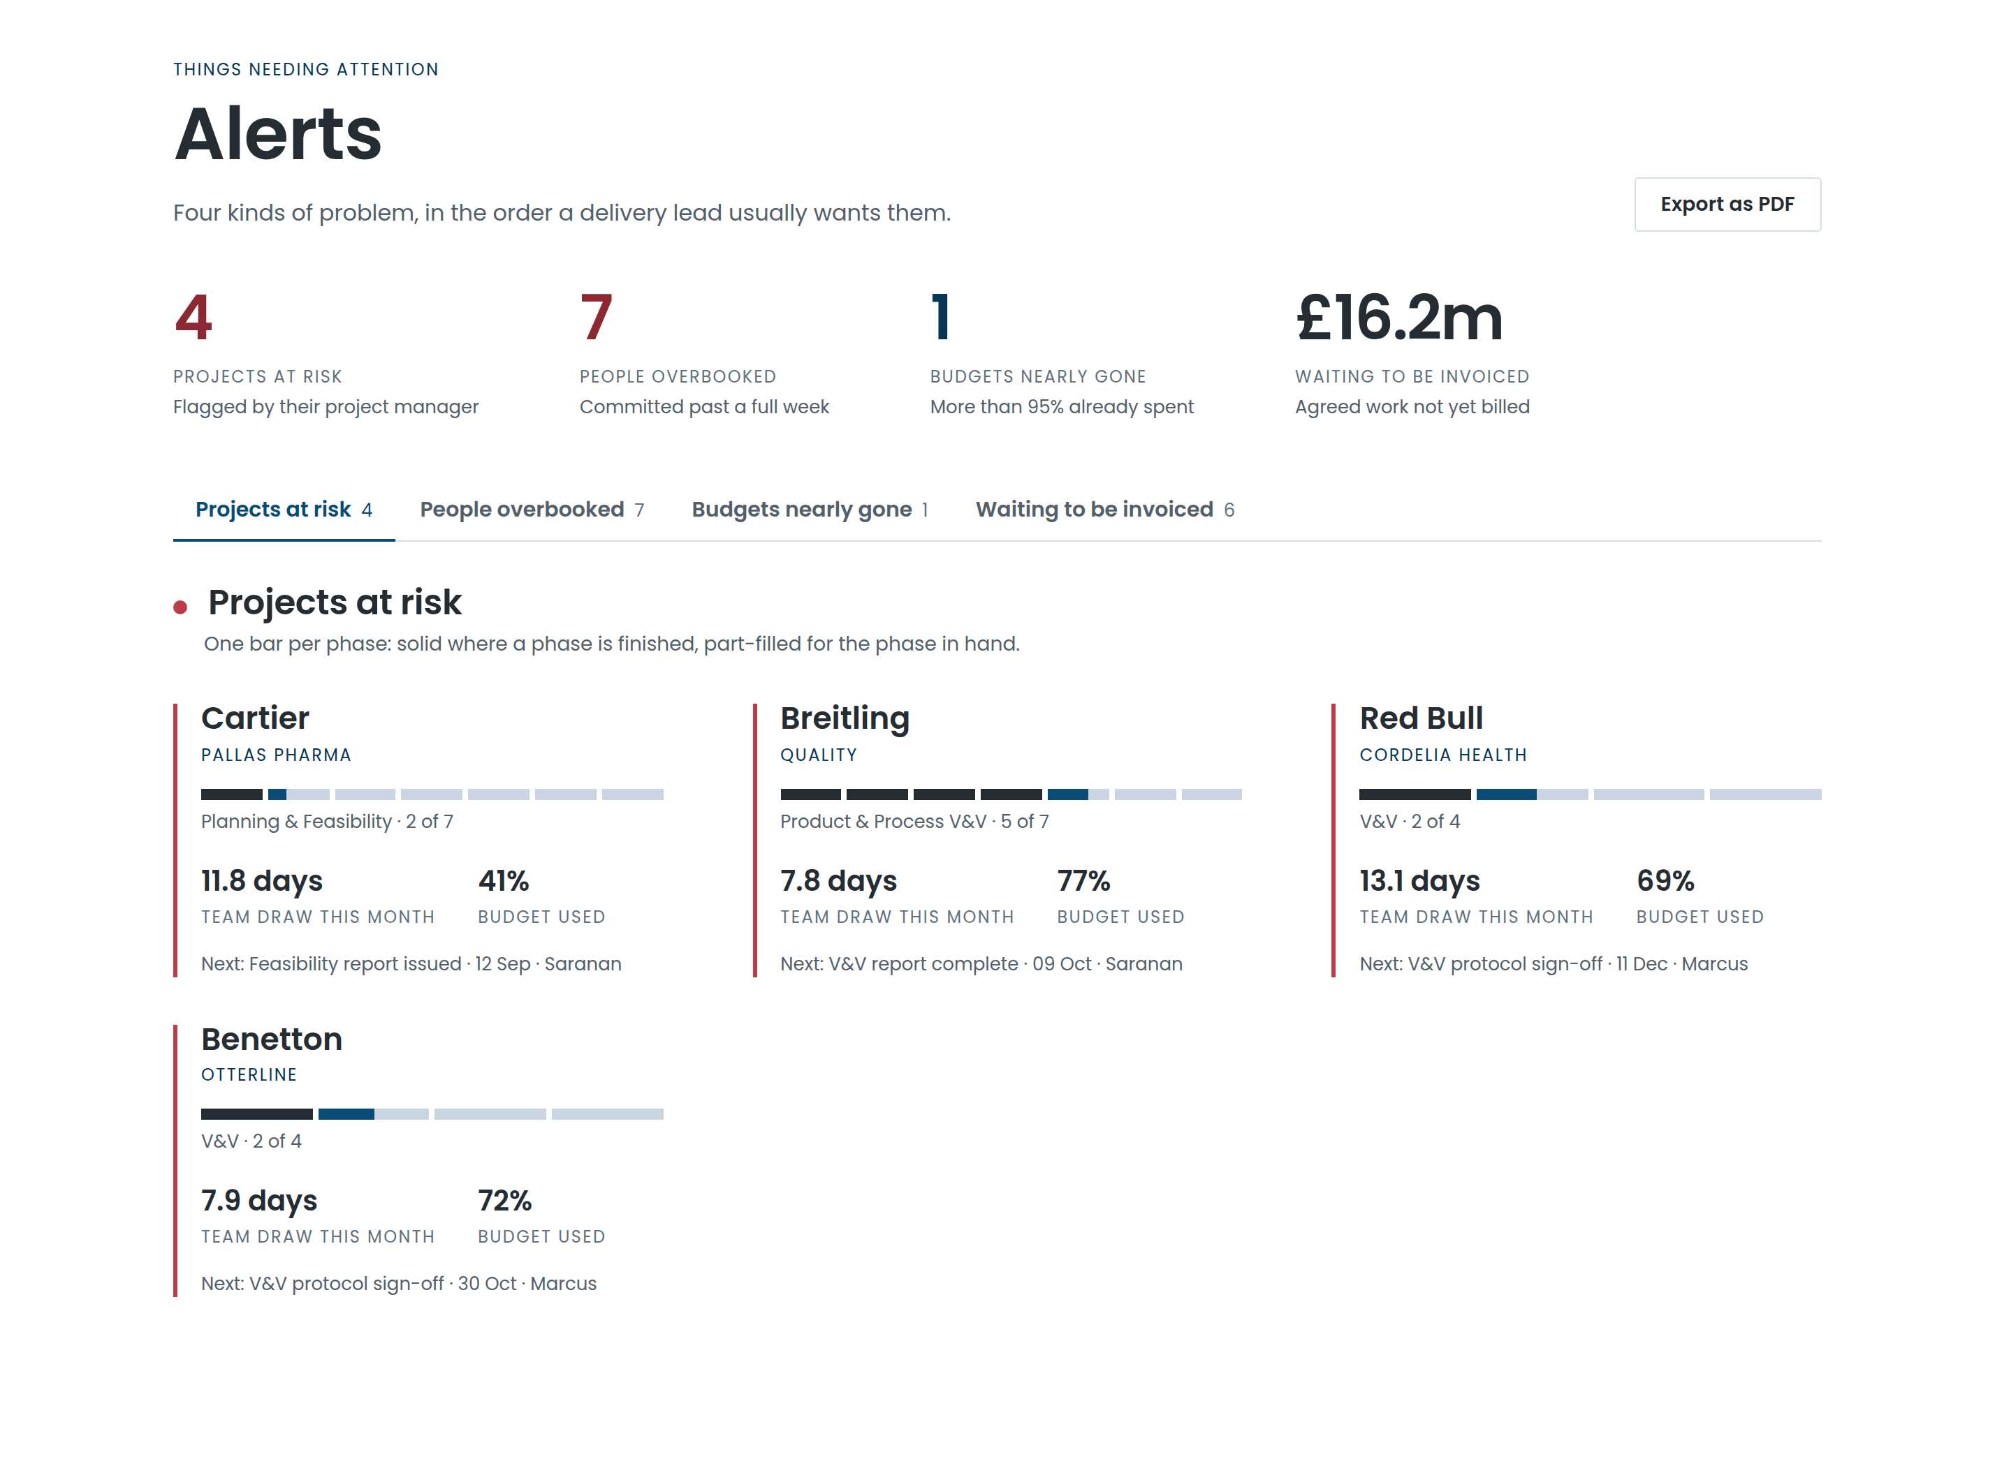
ALERTS
Four kinds of problem, worst first
1
Projects at risk
Flagged by the project manager, with what is driving it.
2
People overbooked
The same detail the resourcing graphs show, per month.
3
Budgets nearly gone
Before the approval conversation, not after.
4
Dates that have passed
Milestones and invoices that quietly went by.
Notes:
Alerts are derived, never typed. Nobody has to remember to raise them, and they cannot go stale, because they are recalculated from the same figures every time the screen is opened.

Slide 14
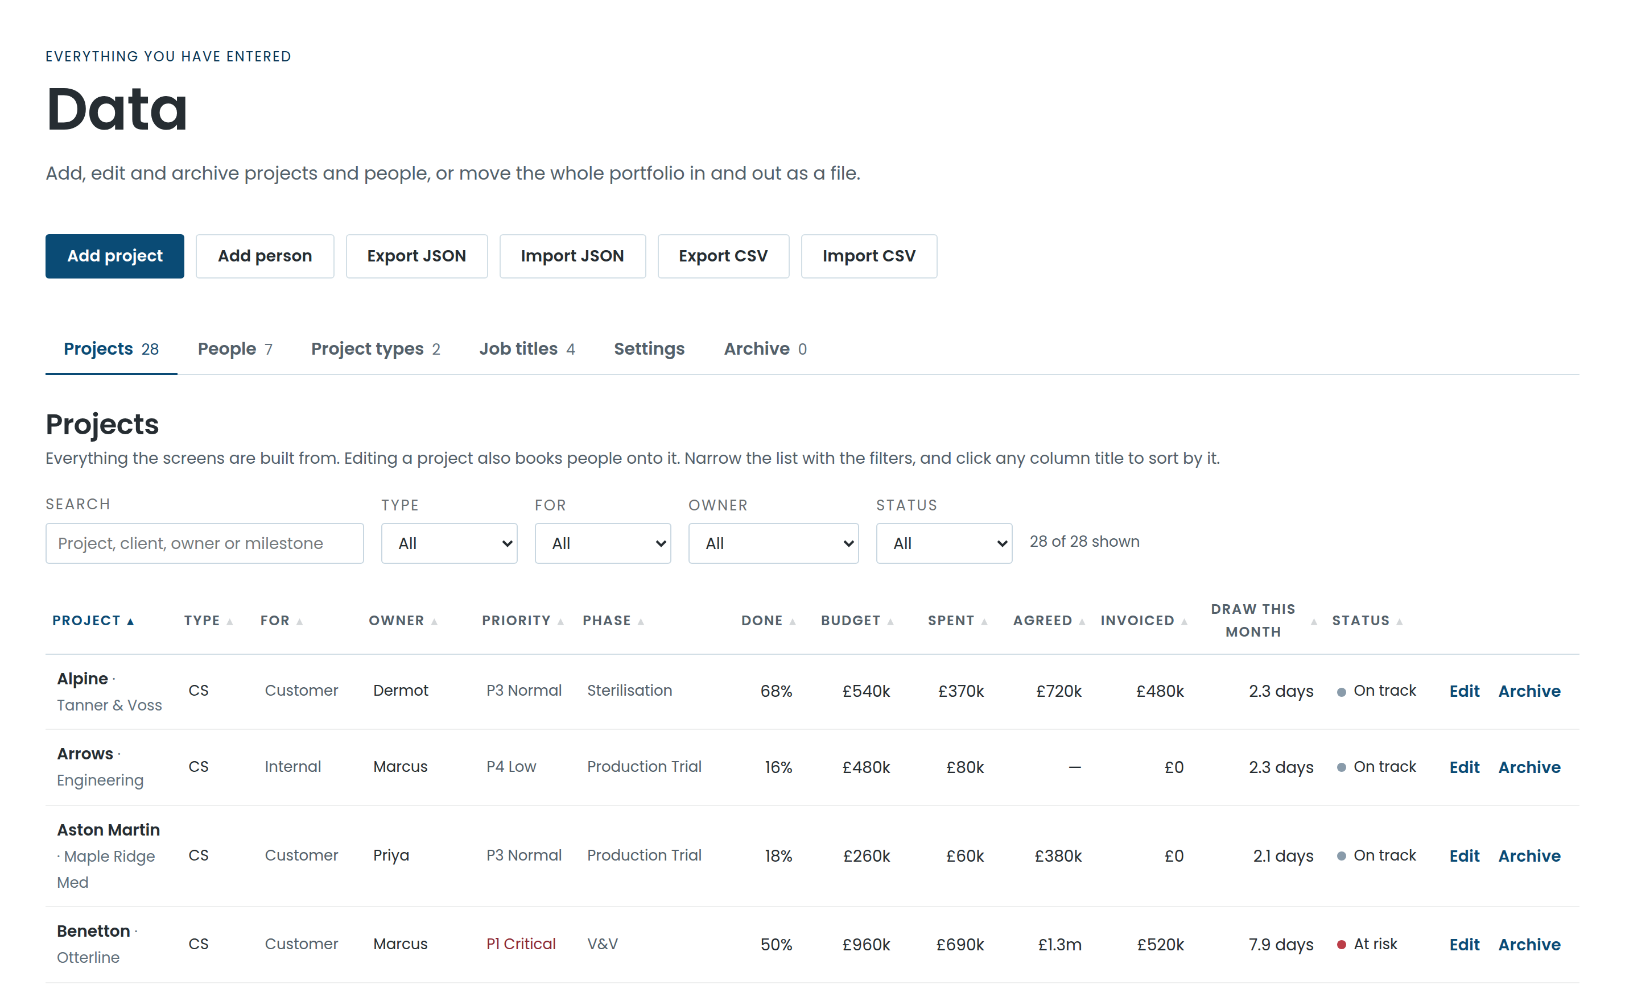
PRACTICALITIES
Your data, your machine
1
Nothing leaves the browser
No server, no account, no data sitting anywhere you did not put it.
2
In and out as a file
Whole portfolio as JSON for a backup; CSV per sheet for everyone else.
3
Light and dark
Reads on a projector in a bright room and on a laptop at midnight.
4
Prints properly
PDF export is laid out for paper, and always in the light theme.
Notes:
Worth saying plainly to the exec: today the data lives in the browser on one machine. Sharing it across devices is a known next step, costed and specified — see the closing slide.

Slide 15

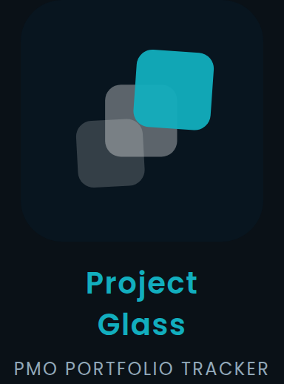
DESIGN
One mark, two grounds
Three translucent panes on a rising diagonal — each stays visible through the last, and where two overlap the colour deepens rather than one hiding the other. The mark is drawn light on paper and dark on navy, and the interface follows the same pair.
The mark on paper
The mark on navy
Lockup, light theme
Lockup, dark theme
THE PALETTE
Navy · #0A4B75
Ink · #073554
Teal · #12AEBE
Paper · #F2F6F9
Alert · #BB3D48
Chrome, links, controls
The dark ground
One highlight only
Cards and raised surfaces
At risk, and nothing else
Set throughout in Poppins — geometric, wide, and legible down to the smallest label on a chart.
Notes:
The palette is not decoration: every colour has one job, which is why the screens stay readable when twenty-eight projects are on one chart. Teal appears once per screen at most — it is the highlight, not a second brand colour.

Slide 16

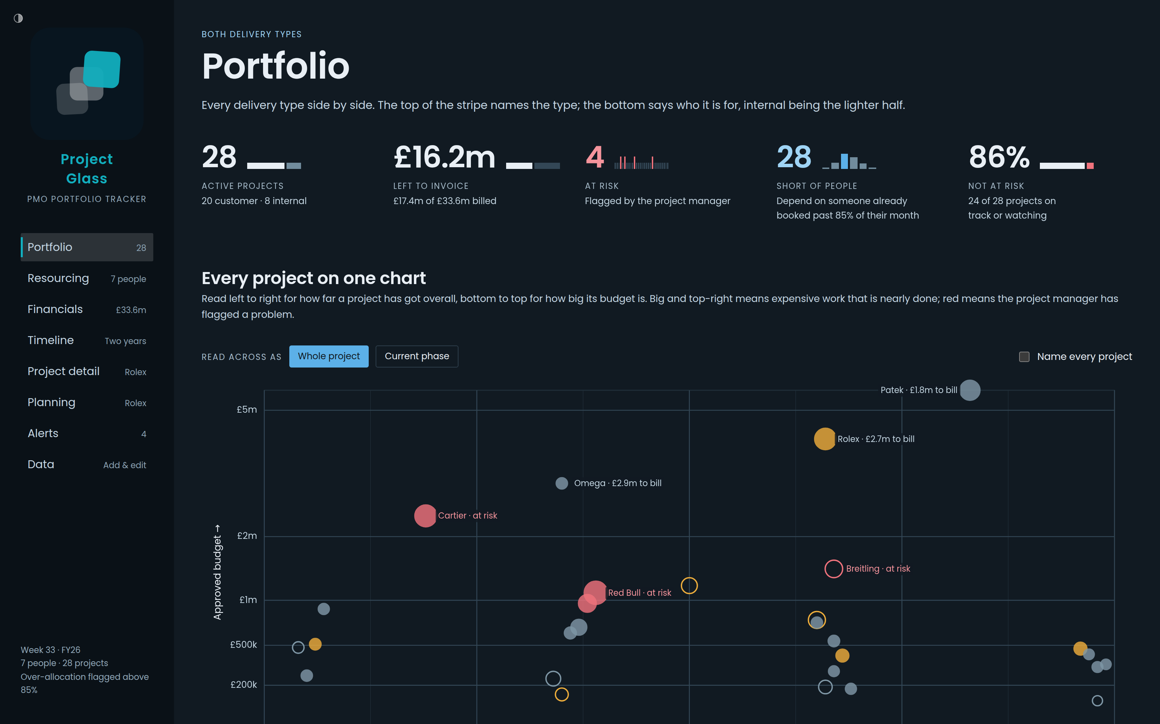
DESIGN
The same screen, either way up
One theme switch in the corner of the menu. Every colour on every screen is a named role rather than a fixed value, so the whole interface turns over at once — and every figure was checked for contrast afterwards, on each screen and in each panel.
Portfolio, light
Portfolio, dark
3,670 pieces of text measured against the ground they are painted on — none below the readable minimum.
Notes:
Worth saying out loud: the dark theme was not eyeballed. Every rendered piece of text on every screen and tab was measured against the colour it actually sits on, and the two that failed were fixed. The data screen and the tables turn over the same way.

Slide 17
ROADMAP
What’s next
Where this goes from here.
1
2
3
Heading
Heading
Heading
Add your point here.
Add your point here.
Add your point here.
Add a closing line here.
Notes:
Placeholder slide — the headings and body text are here to be replaced. The one item already specified and costed is shared storage, so the portfolio follows you between machines rather than living in one browser: roughly a day of work, with the options written up in the repository under docs/shared-data-options.md.

Slide 18
WHAT IT CHANGES
Three conversations it changes
1
For project managers
Plan once. The dates, the phases and the people follow from the same plan instead of being kept in step by hand.
2
For delivery leadership
See the overload before it lands, and the roles that are short for months rather than for a week.
3
For the executive team
One page that says what is at risk, what it is worth, and what it would take to fix — from figures nobody retyped.
Notes:
Close on the ask. The tool is in use today on a single machine; the one thing standing between that and team-wide use is shared storage, which is specified and about a day of work — it belongs on the roadmap slide before this one.

